Slide 2
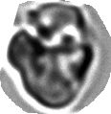
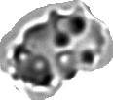

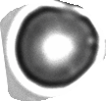









A
Disocyte
B
Stomatocyte
C
Reticulocyte
D
Echino
E
Granular
F
ISC
Unpolymerized
Polymerized
Spherical
Smooth edge
Oval < 1.5
“coffee-bean” shape
Bowl-shaped cells
wrinked
protrusion >2
zigzag
flat surface
Irreversibly sicked cells (ISCs)
Aspect ratio ≥ 1.5
Category

